Slide 1
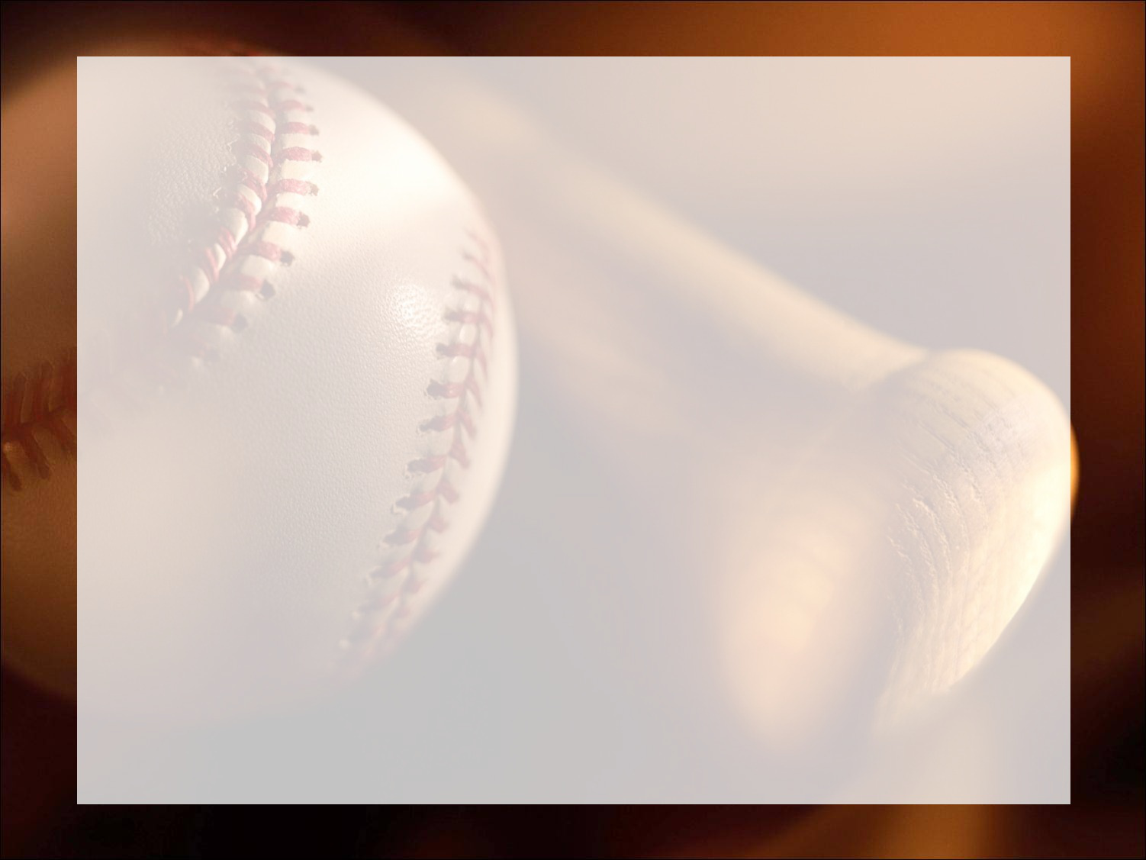

Loyola University - Chicago
2017 SABR Case Competition
Brian Ahern, Daniel Hansen, Donner Kahl,
Andrew Pawlowski, Donald Stolz
Notes:
Updated metric & standardize graph

Slide 2
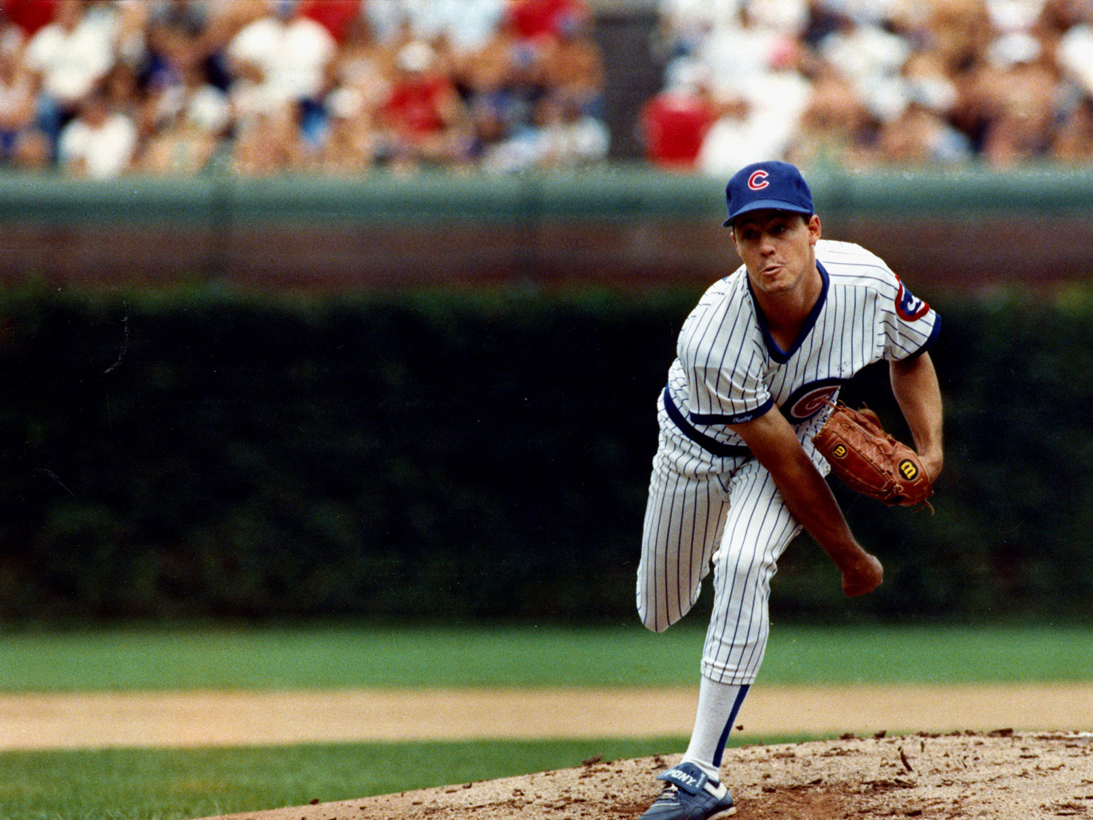
Pitch Tunneling & Sequencing
“You see a pitch inside and wonder, 'Is it the fastball or the cutter?' That's where he's got you.” - Tony Gwynn
“Sometimes he knows what he's going to throw two pitches ahead.”- John Smoltz
Notes:
Greg Maddox, Hall of Fame pitcher who didn’t throw heat. Was able to make each look the same until it was impossible to react
Andy

Slide 3
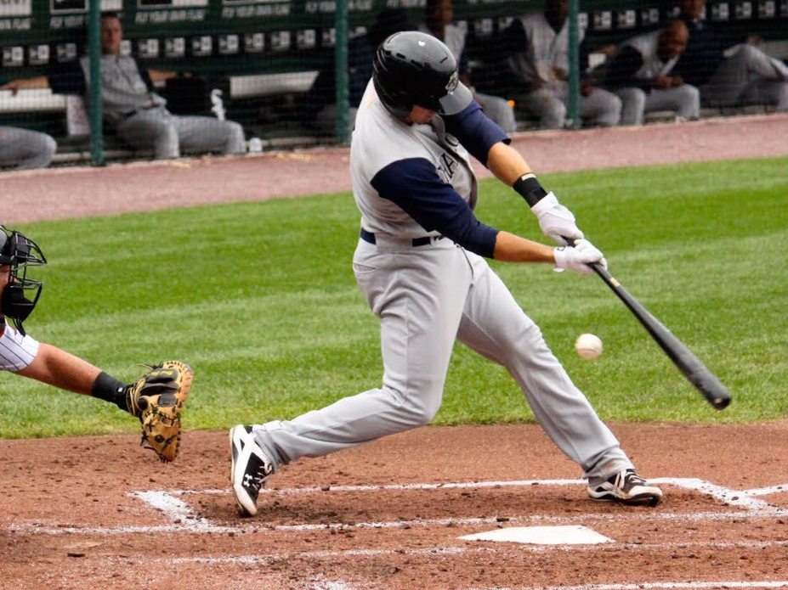
The Problem for Hitters
“Hitting a baseball is the single most difficult thing to do in sport.” - Ted Williams
“The good hitters get their tip-off from the pitchers.”
- Charley Metro
Notes:
Difficult because hitting a baseball traveling already on edge of human reaction limits. The hitters are forced to base swings off tells from the pitcher, it’s critical for pitchers to hide their tells
Andy

Slide 4
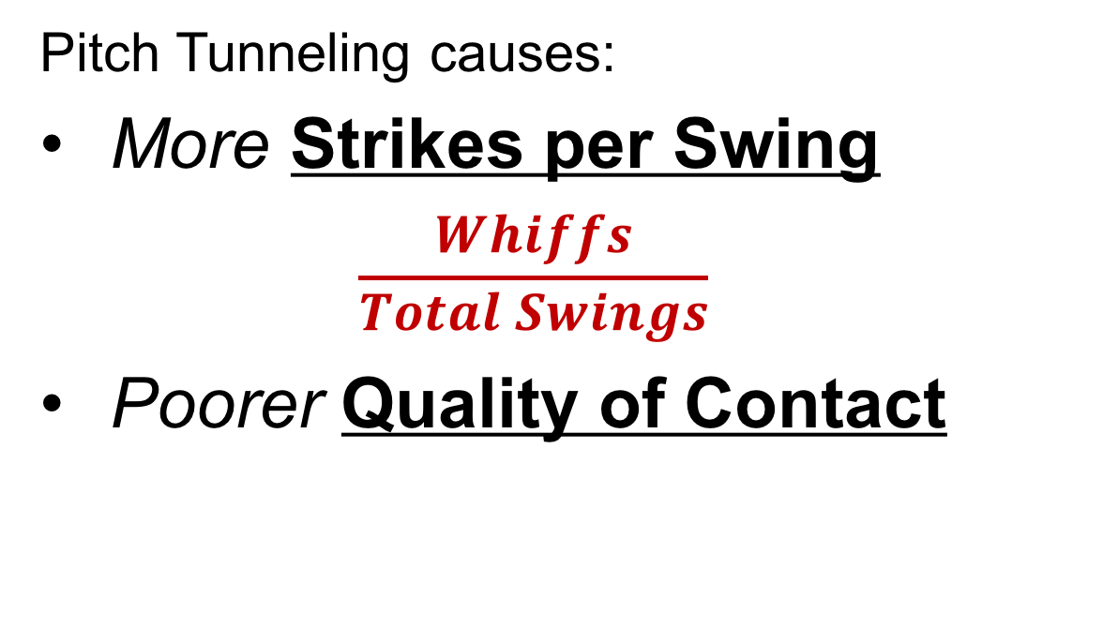
The Hypothesis
Pitch Tunneling causes:
More Strikes per Swing
$$\frac{Whiffs}{Total Swings}$$
Poorer Quality of Contact
Notes:
Andy
3 minutes

Slide 5
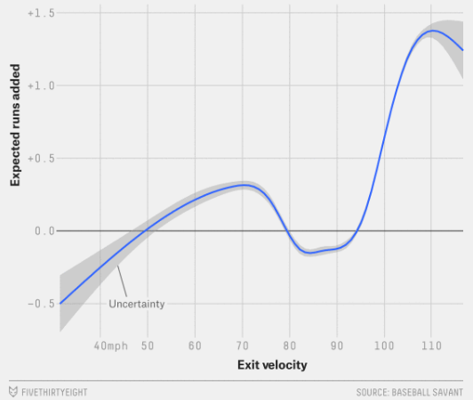
Quality of Contact
A pitcher that tunnels well should limit quality of contact
- Average Velocity as well as
Average launch angle was
Taken for each sequence thrown
-This gives a better idea of the
results of an at bat than just
the actual outcome
Notes:
Danny/Donner

Slide 6
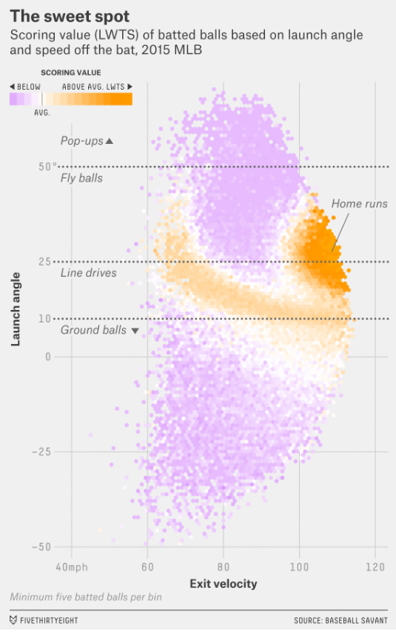
Quality of Contact
Measured Ground Ball %, Fly Ball %,
and Line Drive %
Hypothesize that a
better tunneling
metrics result in
worse launch angles
Notes:
Danny/Donner
5 minutes

Slide 7
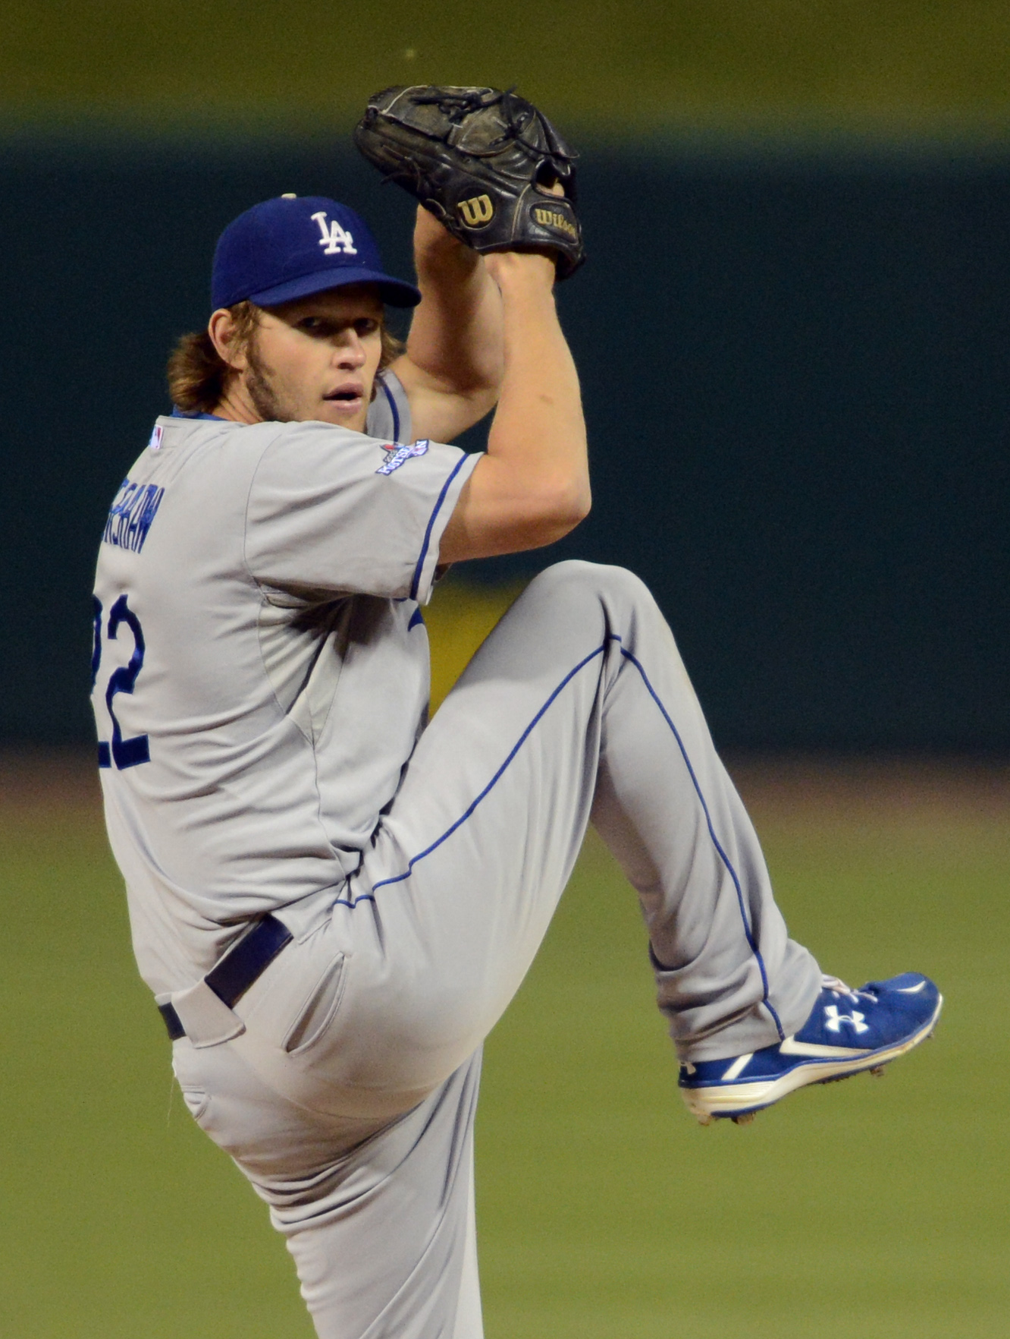
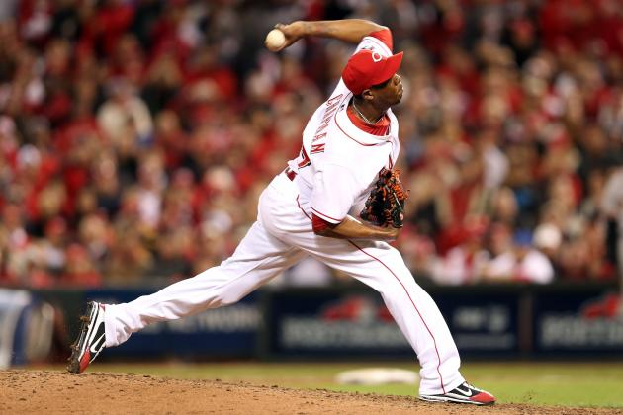
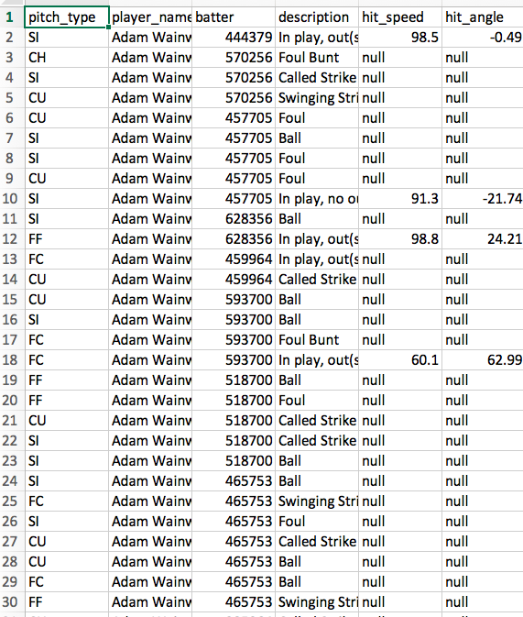
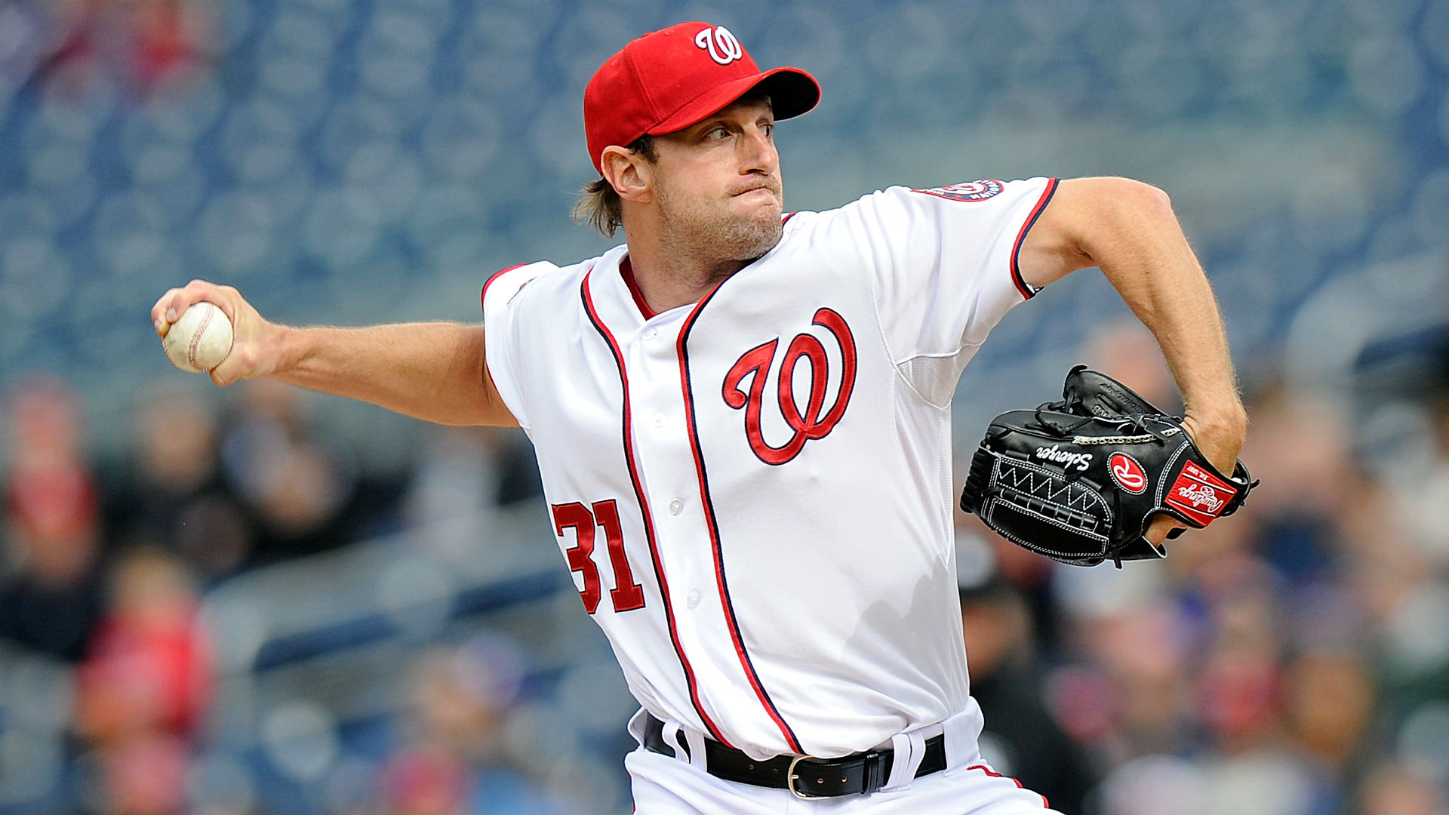
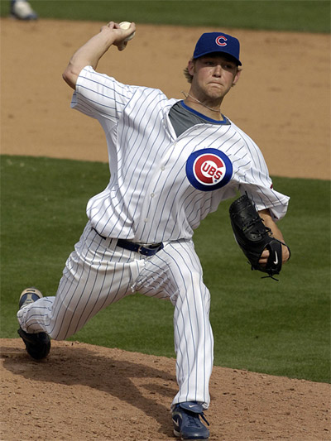
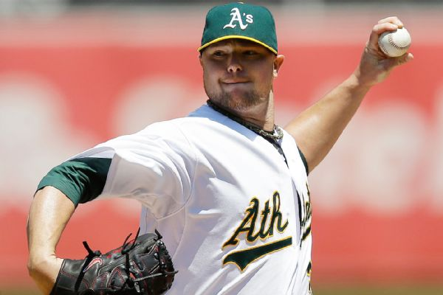
Data Selection
55 Random Pitchers
5 Hand-picked Elite Pitchers
Prospectus – Sequencing
Statcast – Individual Pitch Data
Notes:
92,372 pitches Selected 55 pitchers for our random sample size. Also picked pitchers we felt demonstrated strong pitch tunneling ability
Donner/Don
6.5 Minutes

Slide 8
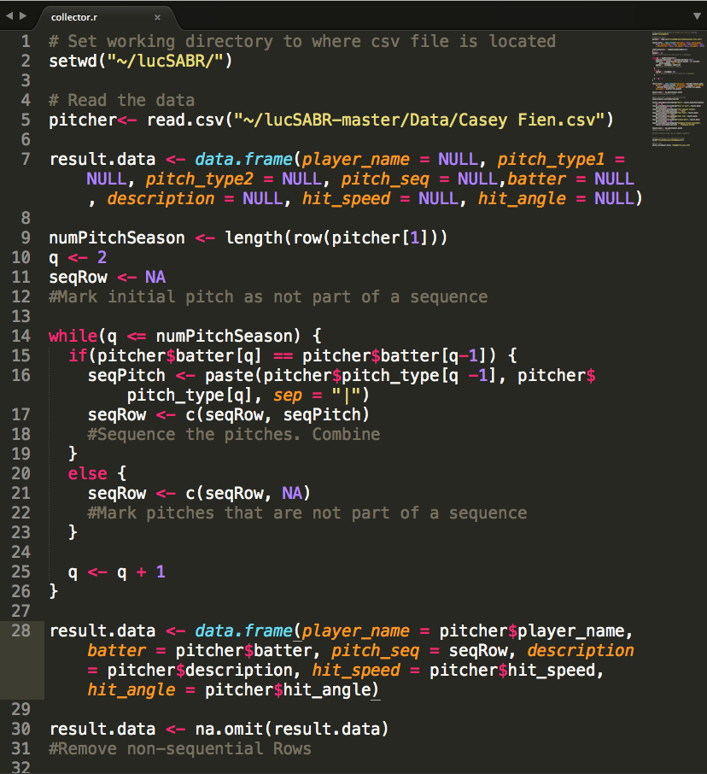
The Collection Process
2016 Season
Every pitch by pitcher
Collect Sequences
Filter swings
Perform calculations by pitch sequences
Separate Best & Worst Tunnelers
Notes:
Collected 2016 season hit_speed, hit_angle, and event description. Sorted sequences by at bats. Filtered into only pitches swung at Fouls, & swinging strikes. Calculated hit ground%, lineDrive%, flyBall% 92,372 pitches
Don
8 minutes

Slide 9
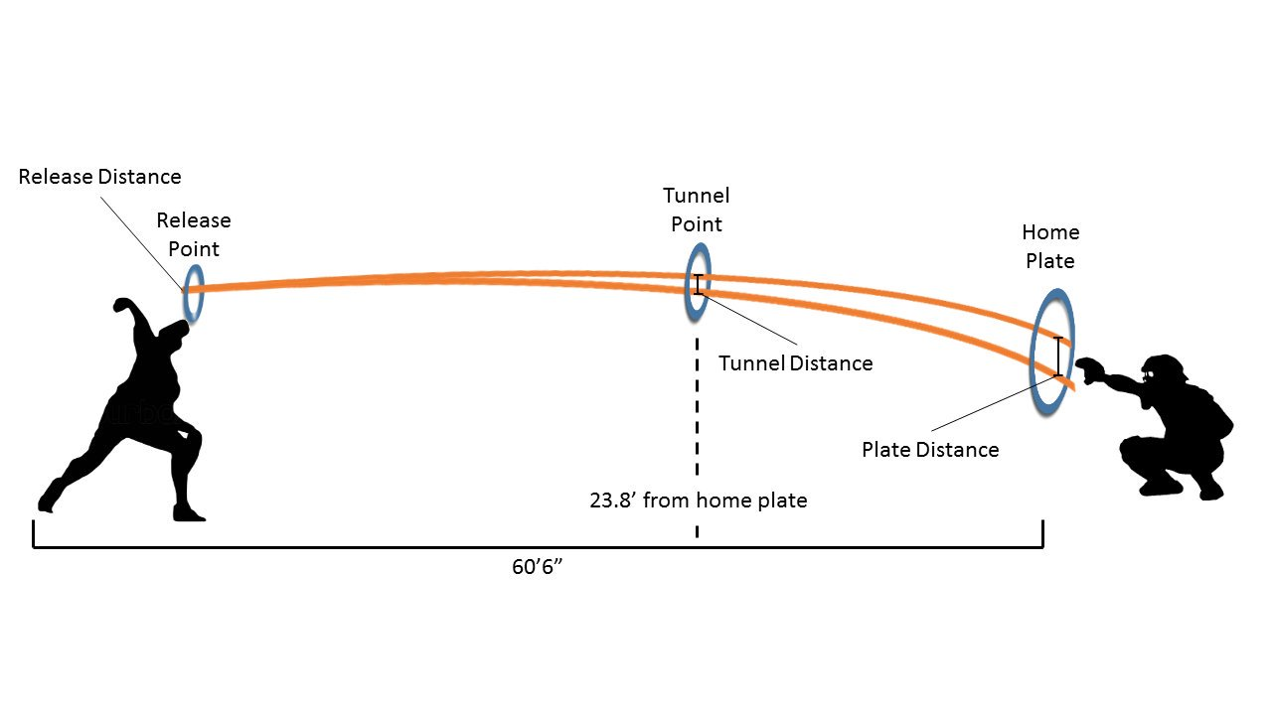
Pitch Tunneling Metrics
Notes:
Pitch tunneling measures how well pitchers can disguise their pitches.

Slide 10
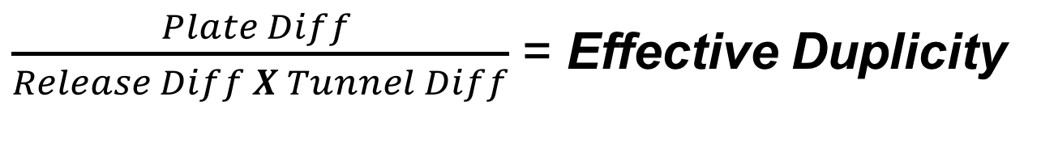
Measuring Tunnel Quality
$\frac{Plate Diff }{Release Diff X Tunnel Diff}$ = Effective Duplicity
Notes:
Equation was updated/corrected after competition. Graphs show decent correlation, but updated equation should yield more accurate results

Slide 11
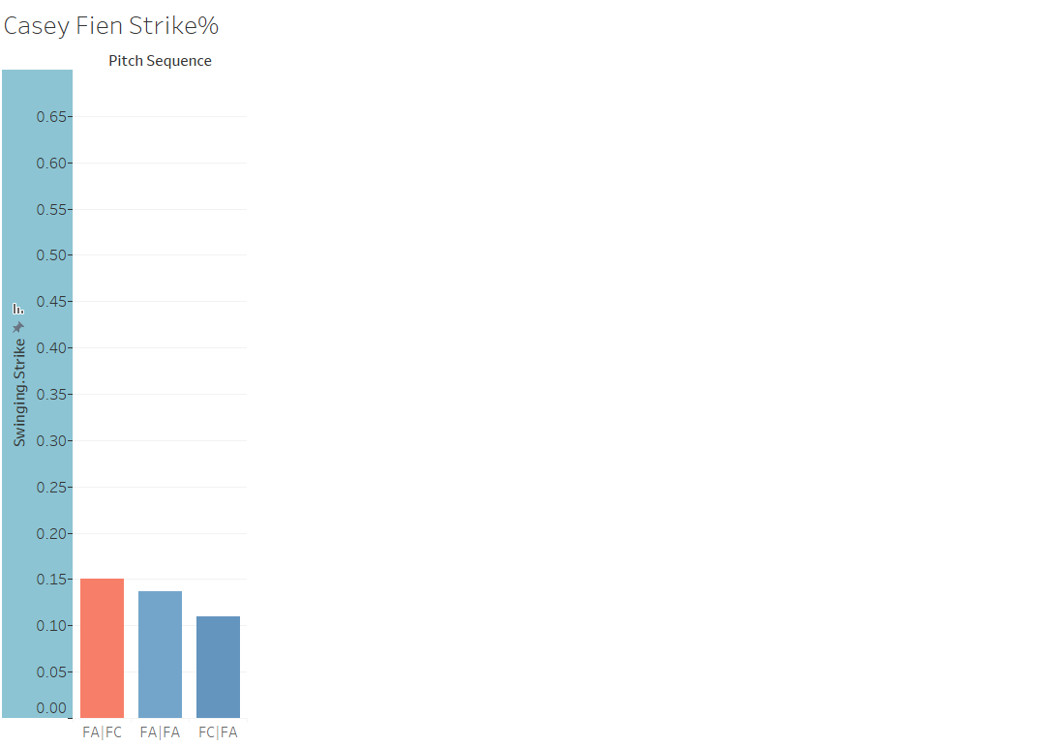
FA|FC = 4.77
FA|FA = 11.76
FC|FA = 4.94

Slide 12
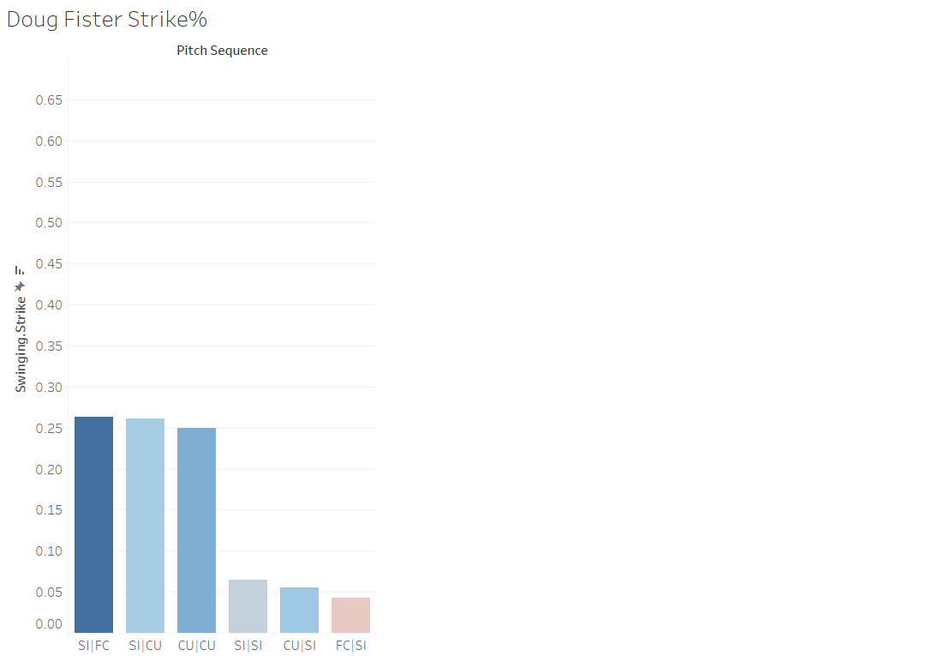
SI|FC = 5.55
SI|CU = 8.37
CU|CU = 8.27
SI|SI = 7.52
CU|SI = 9.70

Slide 13
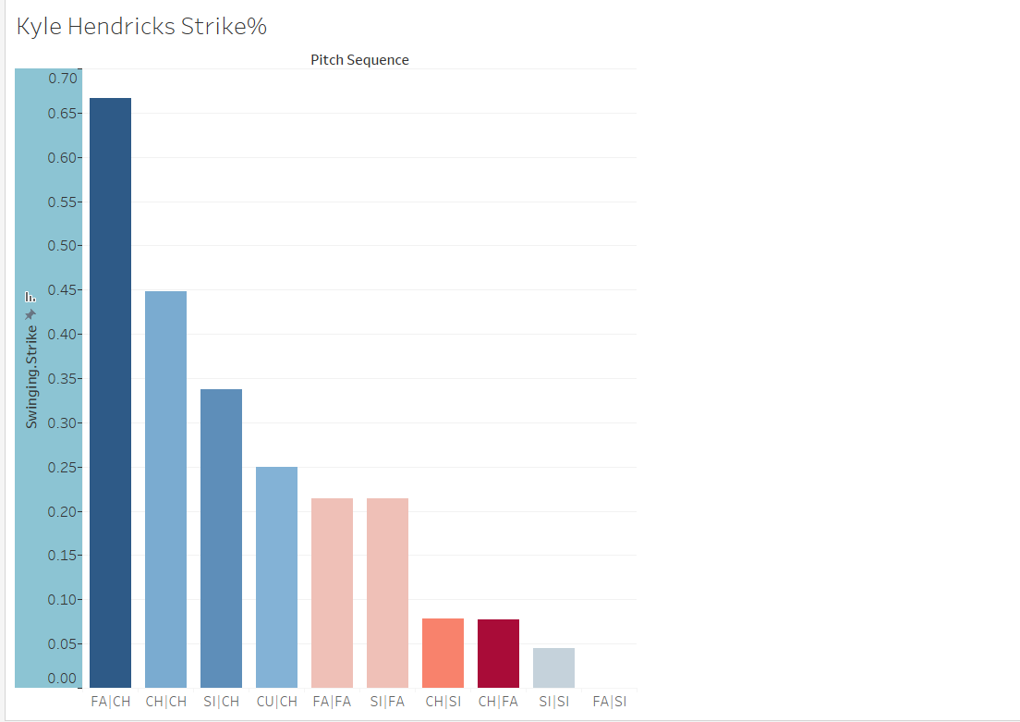
FA|CH = 18.85
CH|CH = 18.02
SI|CH = 12.27
CU|CH = 12.73
FA|FA = 14.54
SI|FA = 10.46
CH|SI = 12.22
CH|FA = 16.69
SI|SI = 14.85

Slide 14
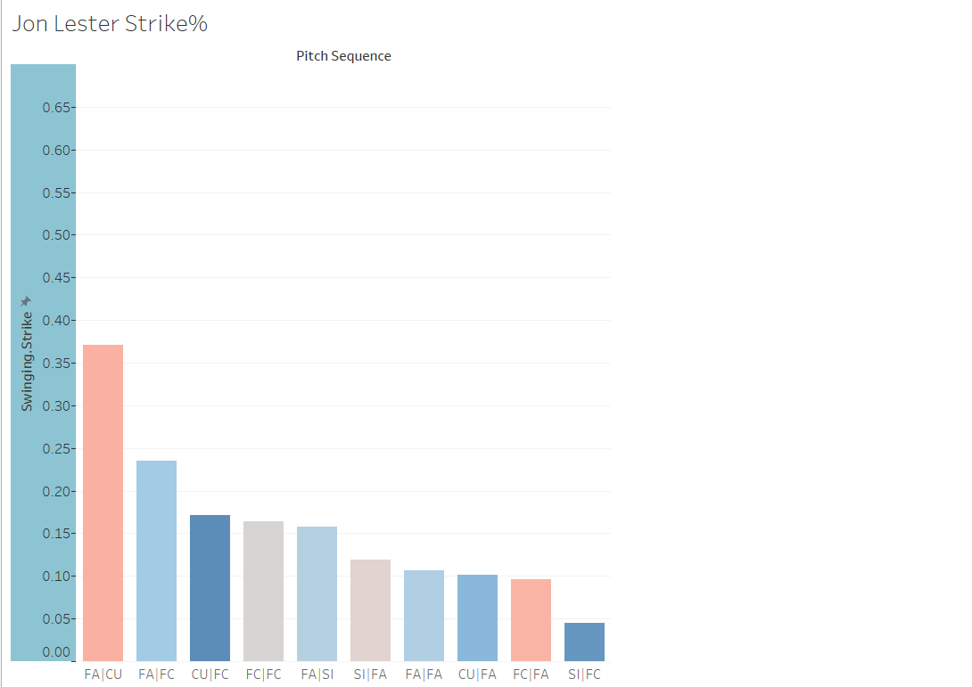
FA|CU = 18.34
FA|FC = 21.65
CU|FC = 11.27
FC|FC = 21.27
FA|SI = 14.72
SI|FA = 17.51
FA|FA = 20.00
CU|FA = 14.02
FC|FA = 21.01
SI|FC = 15.13
Notes:
FC looks like an FA

Slide 15
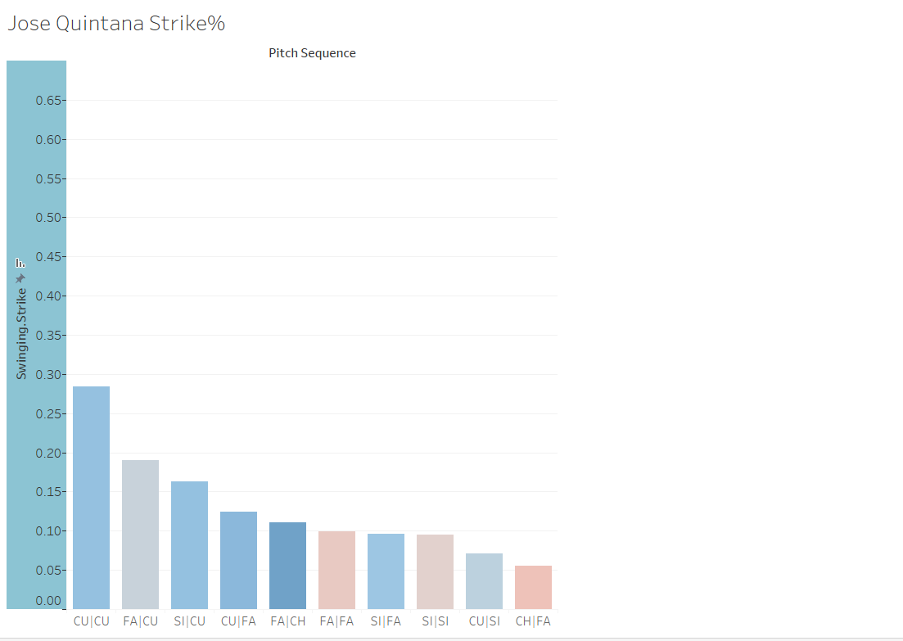
CU|CU = 14.96
FA|CU = 13.35
SI|CU = 11.81
CU|FA = 12.24
FA|CH = 15.64
FA|FA = 14.92
SI|FA = 15.43
SI|SI = 14.27
CU|SI = 12.67
CH|FA = 12.96

Slide 16
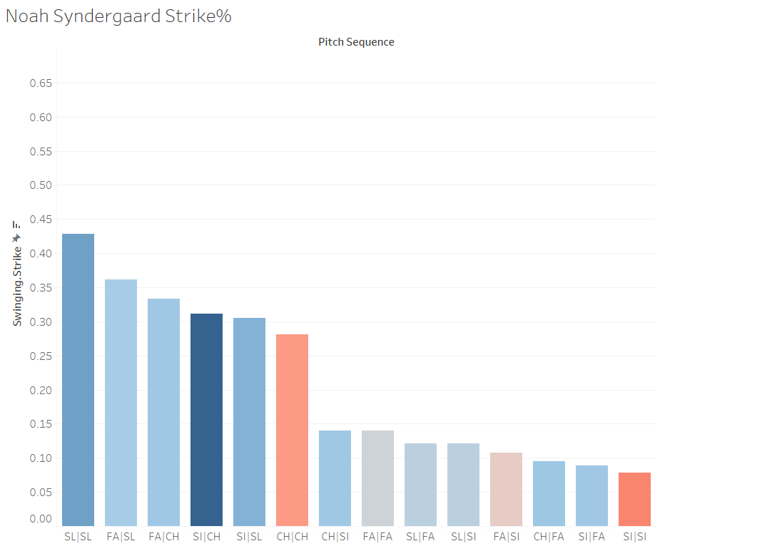
SL|SL = 13.90
FA|SL = 13.37
FA|CH = 5.58
SI|CH = 4.45
SI|SL = 11.94
CH|CH = 13.66
CH|SI = 4.51
FA|FA = 13.18
SL|FA = 12.67
SL|SI = 11.91
FA|SI = 12.80
CH|FA = 5.04
SI|FA = 14.01
SI|SI = 13.28

Slide 17
Conclusions
Our metric shows a relationship with some pitcher’s most effective sequence
Was also promising for Quality Contact

Slide 18
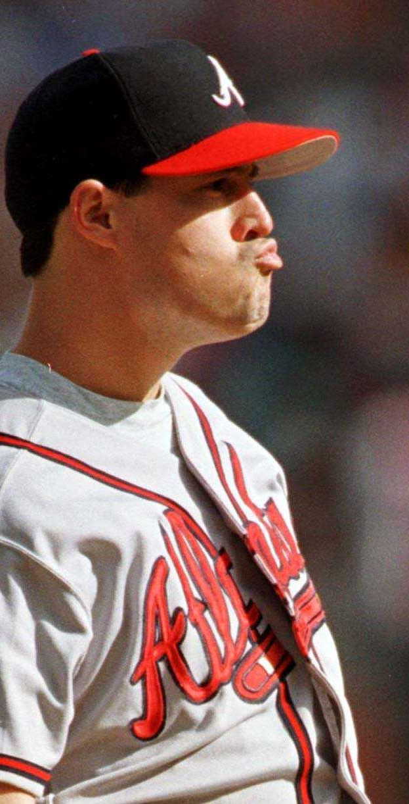
Importance
Allows us to measure the effectiveness of a pitcher to force swinging strikes
Specifically low-velocity pitcher

